Slide 1
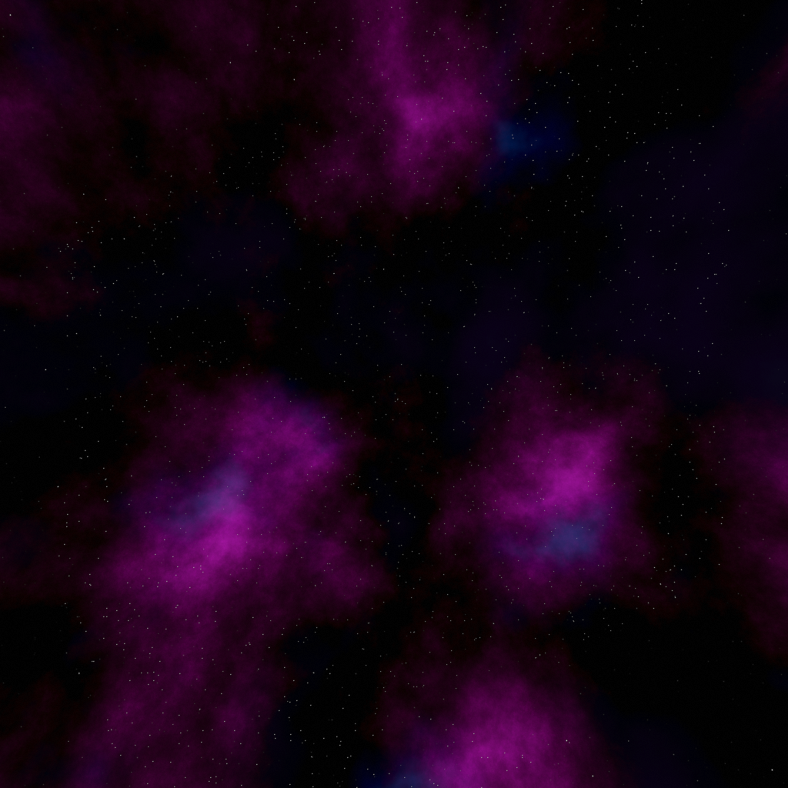

Unity 3D
Real example
Evgeniy Kulyk
July 05, 2014

Slide 2

Agenda
Project Hierarchy
Flow
Component System
NGUI

Slide 3
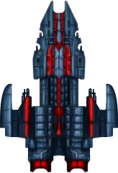
Time To Code
Start Screen
Making Player
Creating Enemy
Making Enemies smart (kind of)
Managing Enemy groups
Tracking Game progress (You’ll win! Someday… )

Slide 4

Template Text
Template text Template text
Template text Template text
Template text Template text
Template text Template text
Template text Template text

